Slide 1
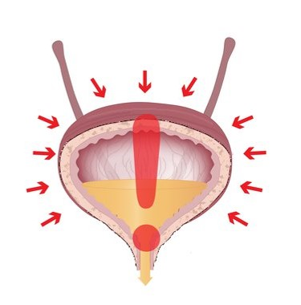
Diagnosing lower urinary tract dysfunction using bladder pressure data
Gilgal Ansah
Applied Neural Interfaces Lab
February 2021

Slide 2
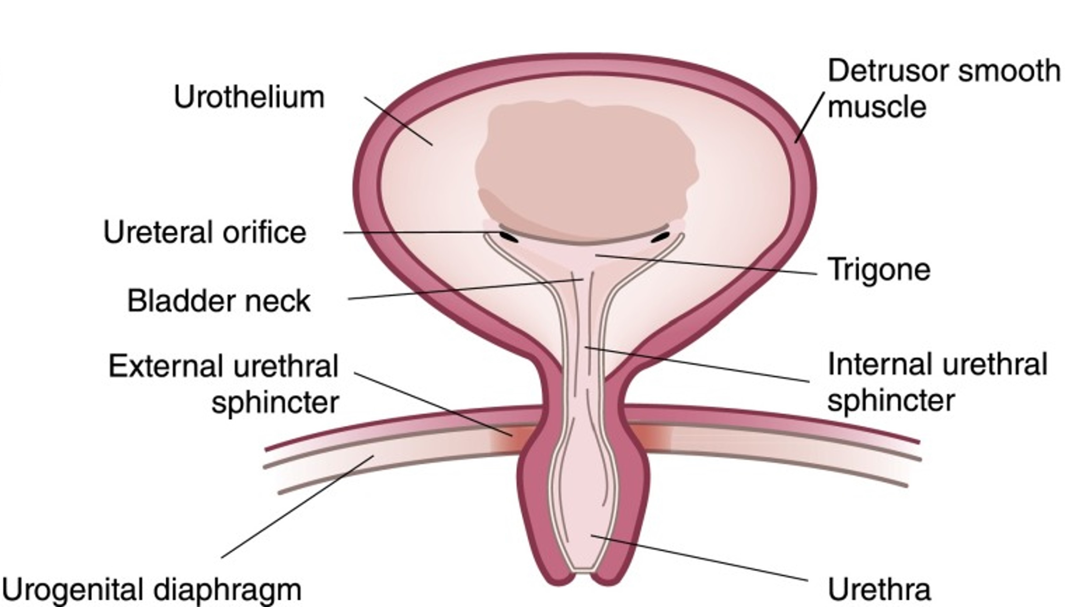
Background
Continence/Storage/Off
Low intravesical pressure
Detrusor relaxes
EUS contracts
Micturition/Expulsion/On
High Pressure
Detrusor contracts
IUS relaxes

Slide 3
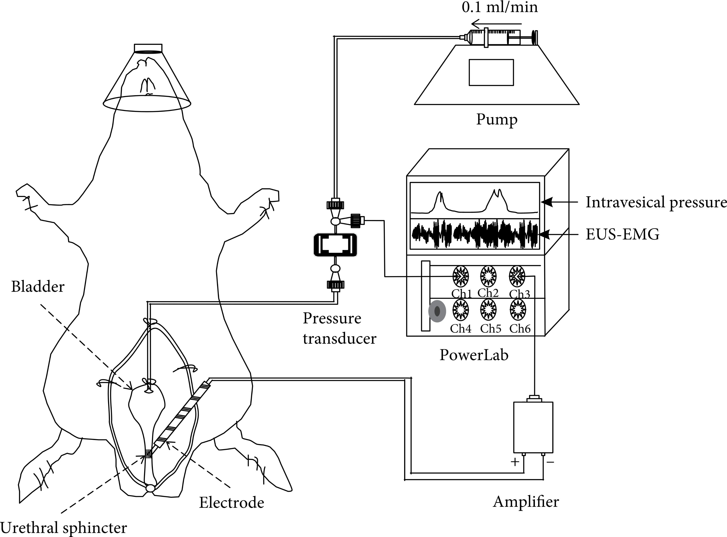
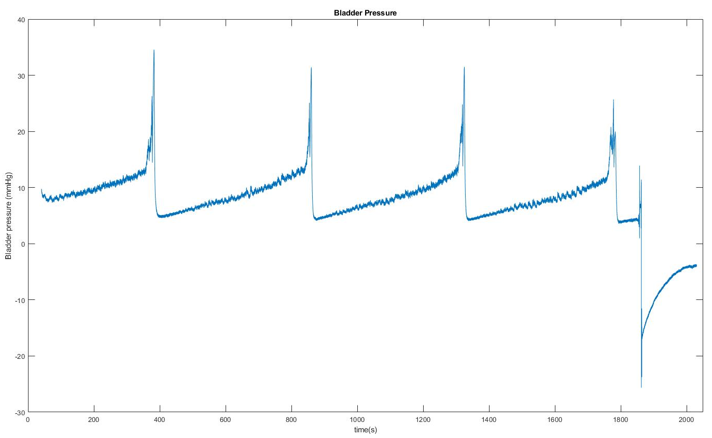
Cystometry Bladder Pressure Time Series
$$Voiding Efficiency=\frac{Voided Volume}{Voided Volume+Residual Volume}$$

Slide 4
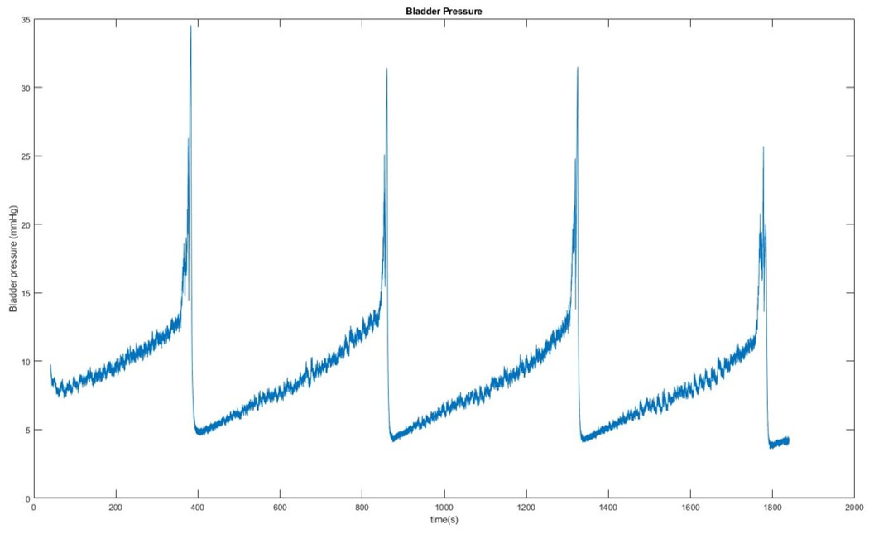
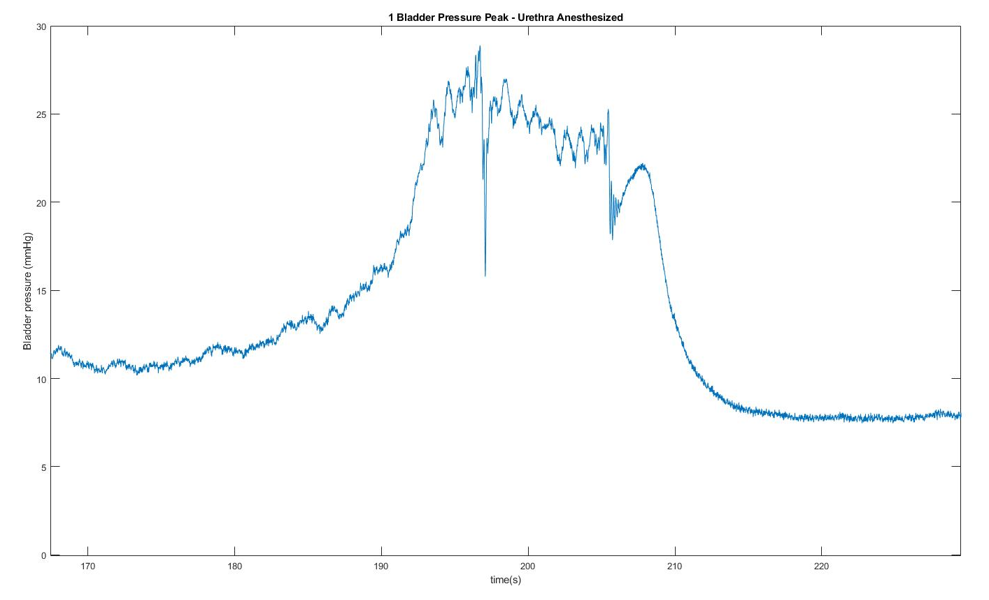
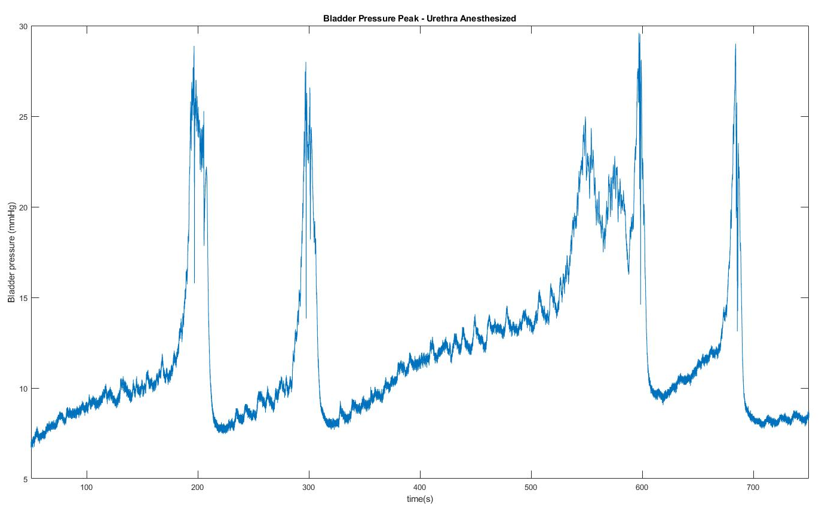
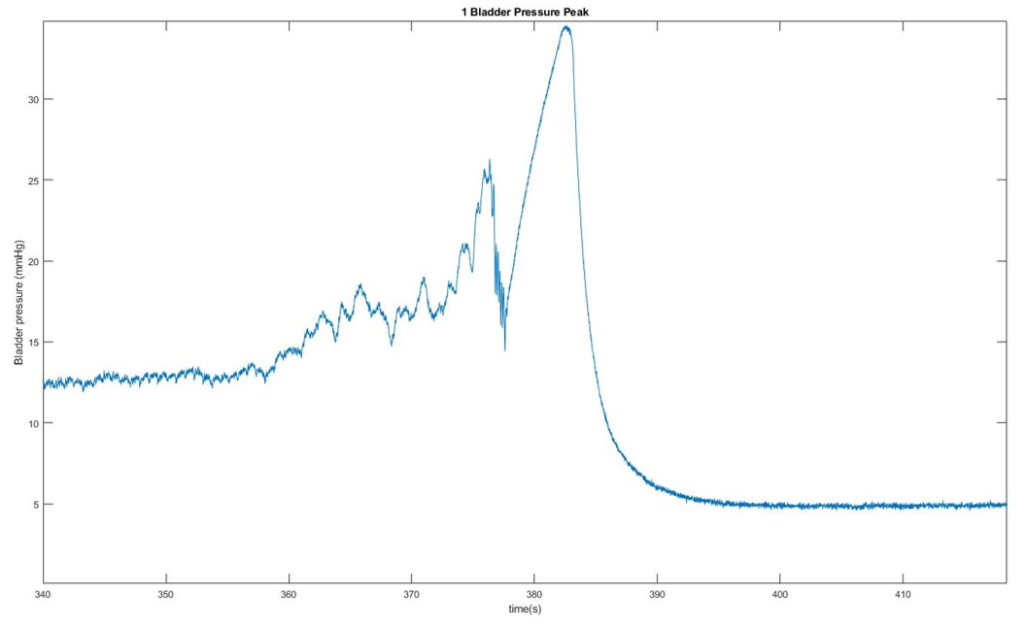

Slide 5
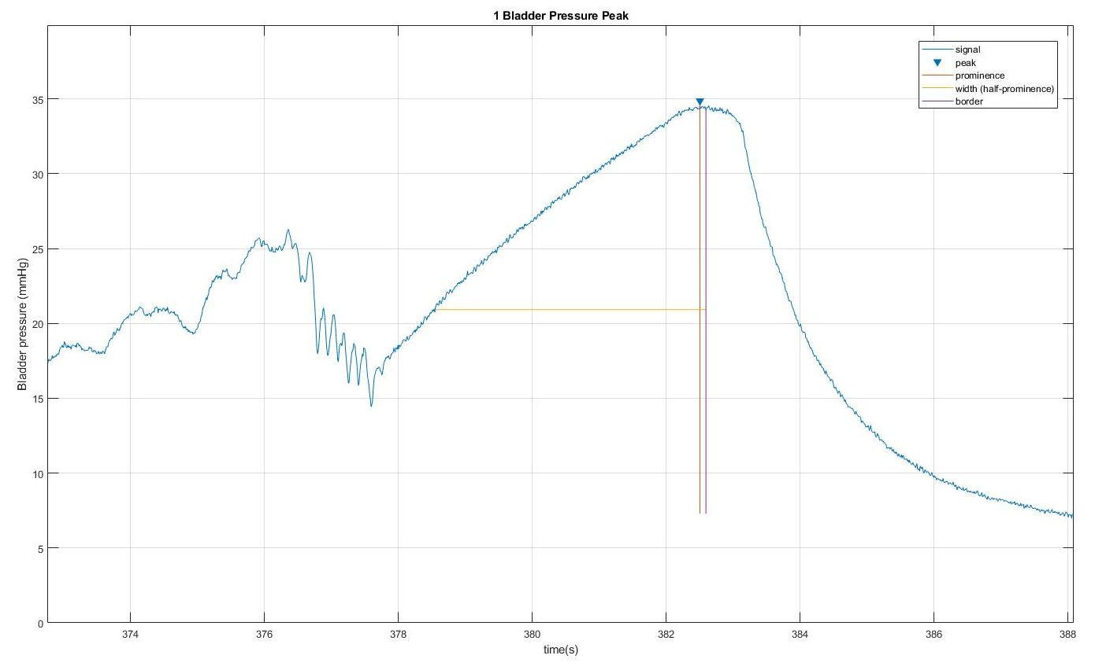
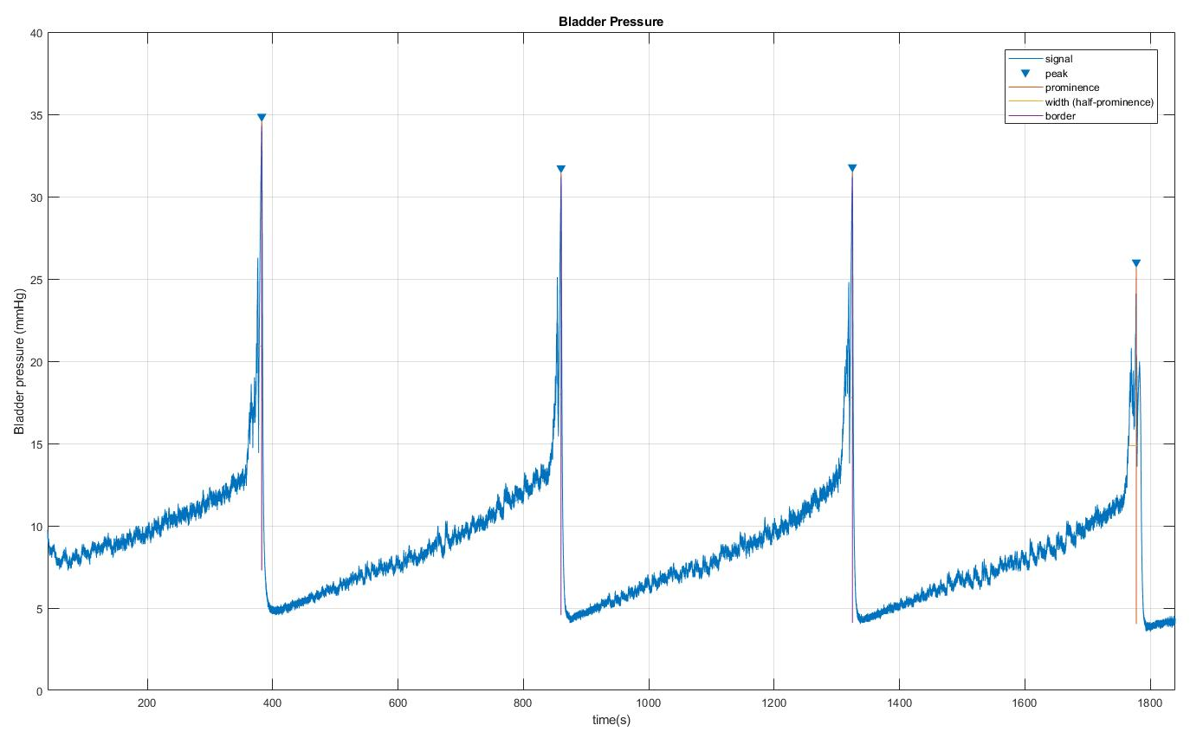
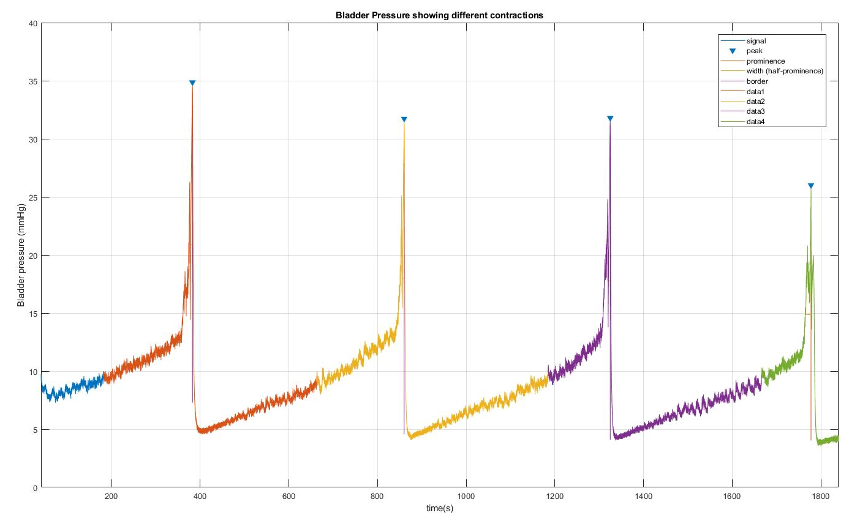
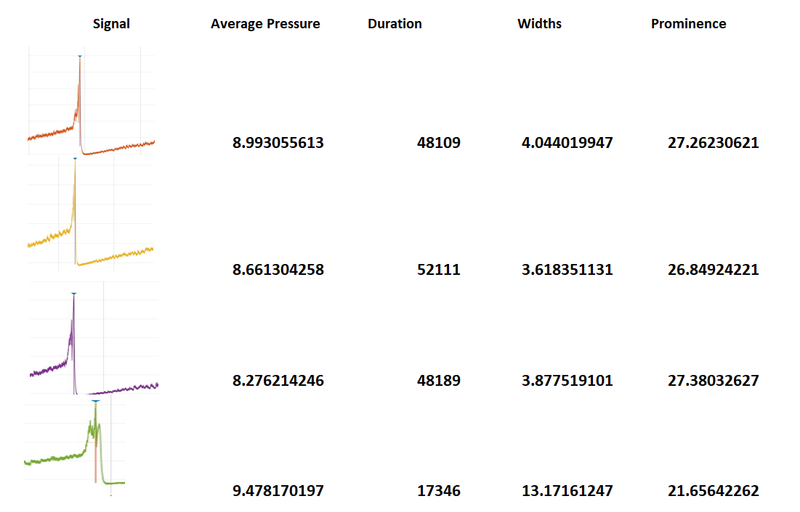
Data Analysis Plan
Identifying and extracting individual voids
MATLAB® findpeaks fcn
Extract entire contractions
Baseline (10mmHg)
Feature extraction
Peak width
Peak prominence
Contraction duration
Average pressure, etc.
Cluster
Principal Component Analysis
K-means

Slide 6
Challenges and further considerations
Good measure of baseline activity?
Time align contractions (sample lengths)
Extract other features?
Multivariate Statistical Analysis (LDA)?

Slide 7
References
Sheng-Fei Xu, Guang-Hui Du, Kuerbanjiang Abulikim, Peng Cao, Hui-bing Tan, "Verification and Defined Dosage of Sodium Pentobarbital for a Urodynamic Study in the Possibility of Survival Experiments in Female Rat", BioMed Research International, vol. 2020, Article ID 6109497, 8 pages, 2020. https://doi.org/10.1155/2020/6109497
Hill WG. Control of urinary drainage and voiding. Clin J Am Soc Nephrol. 2015 Mar 6;10(3):480-92. doi: 10.2215/CJN.04520413. Epub 2014 Apr 17. PMID: 24742475; PMCID: PMC4348679.
https://bjuiknowledge.bjuinternational.com/curriculum-section/bph-and-lut-dysfunction/

